Slide 1

PORTFOLIO / 2026
BREWING
BUSINESS
INSIGHTS
Bright Coffee Shop • Sales Analytics
BRIDGET MOTHOMOHOLO

Slide 2

BRIGHT / COFFEE SHOP
THE PROJECT
From transactions to decisions
THE CHALLENGE
How can a coffee shop use everyday sales data to improve performance?
This case study turns an Excel sales dataset into clear KPIs, performance comparisons and practical business recommendations.
BRIDGET MOTHOMOHOLO • DATA ANALYTICS PORTFOLIO
02 / 12

Slide 3
BRIGHT / COFFEE SHOP
EXECUTIVE SUMMARY
The numbers behind the brew
TOTAL REVENUE
TRANSACTIONS
698,812.33
149,116
UNITS SOLD
REVENUE / SALE
214,470
4.69
BRIDGET MOTHOMOHOLO • DATA ANALYTICS PORTFOLIO
03 / 12

Slide 4
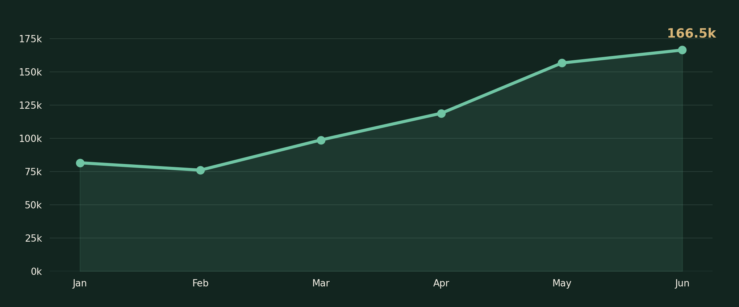
BRIGHT / COFFEE SHOP
REVENUE TRENDS
Revenue grows month by month
PEAK MONTH
June recorded the highest revenue in the period.
Monthly revenue (Jan–Jun)
BRIDGET MOTHOMOHOLO • DATA ANALYTICS PORTFOLIO
04 / 12

Slide 5
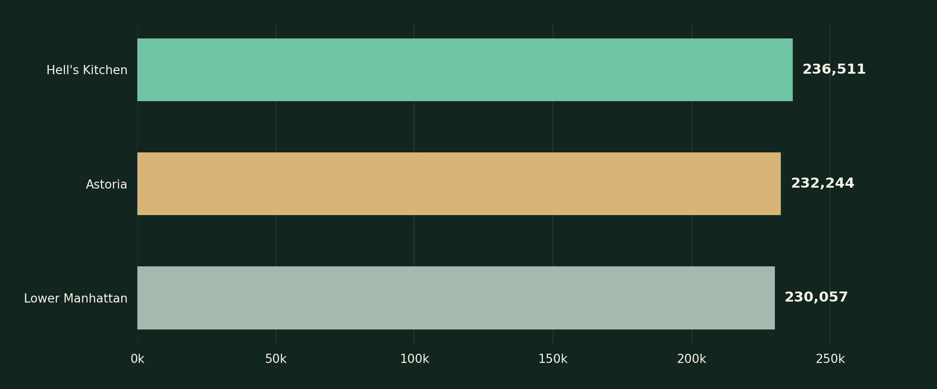
BRIGHT / COFFEE SHOP
STORE PERFORMANCE
Which store leads sales?
TOP LOCATION
Hell’s Kitchen generated the most revenue.
Total revenue by store | Jan–Jun
BRIDGET MOTHOMOHOLO • DATA ANALYTICS PORTFOLIO
05 / 12

Slide 6
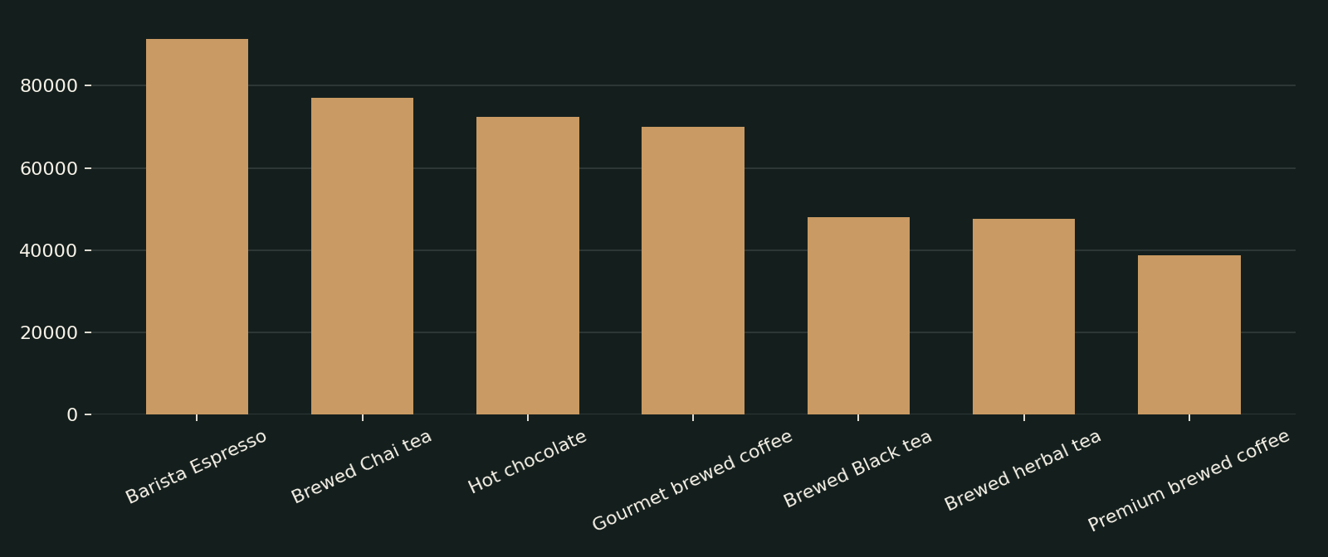
BRIGHT / COFFEE SHOP
PRODUCT PERFORMANCE
What customers are buying
TOP PRODUCT
Barista Espresso leads product-type revenue.
Revenue by product type
BRIDGET MOTHOMOHOLO • DATA ANALYTICS PORTFOLIO
06 / 12

Slide 7
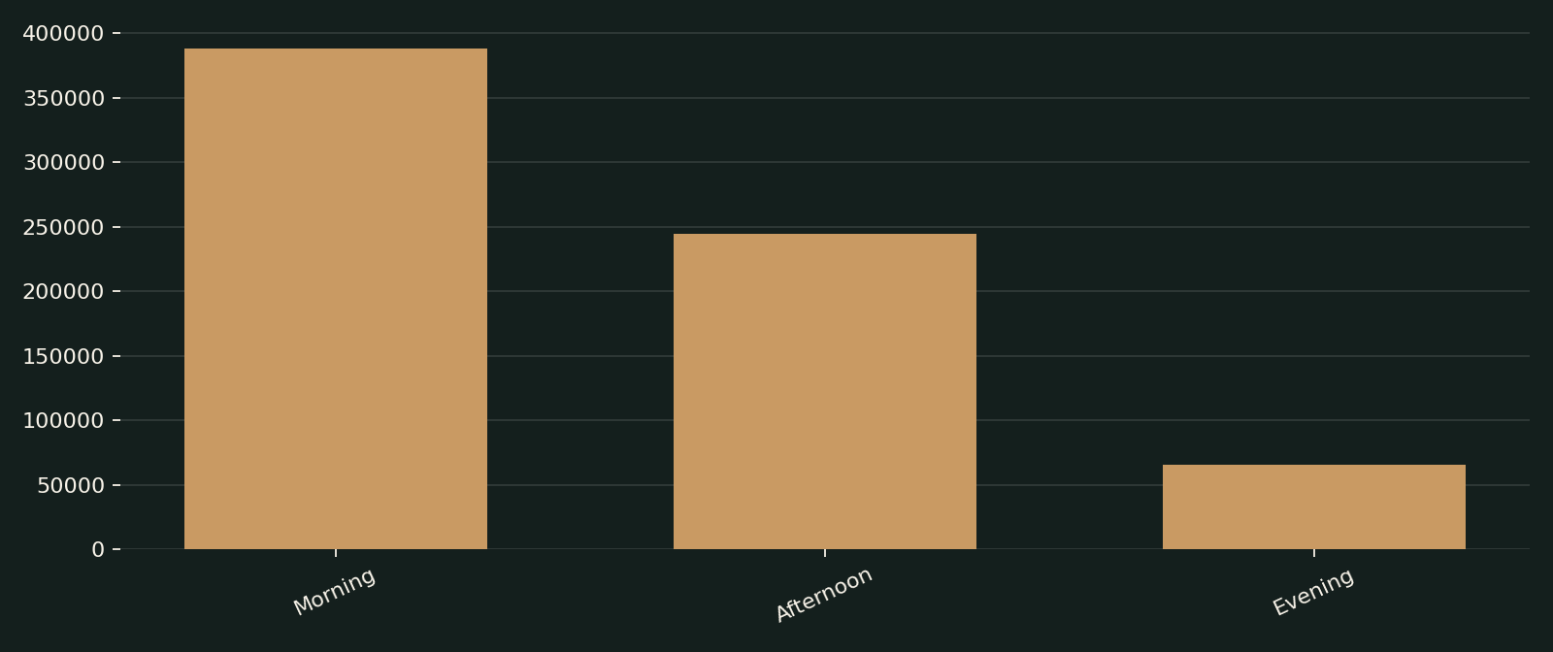
BRIGHT / COFFEE SHOP
SALES PATTERNS
When sales are strongest
PEAK PERIOD
Morning is the strongest time-of-day segment.
Revenue by time of day
BRIDGET MOTHOMOHOLO • DATA ANALYTICS PORTFOLIO
07 / 12

Slide 8
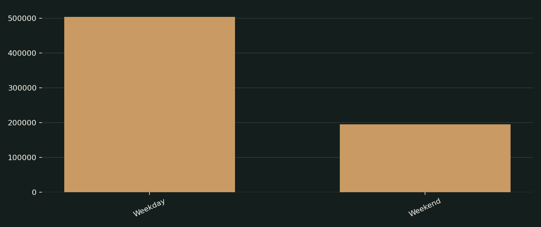
BRIGHT / COFFEE SHOP
SALES PATTERNS
Weekdays versus weekends
SALES MIX
Weekdays account for more total revenue; compare per-day averages for fairness.
Weekday vs weekend revenue
BRIDGET MOTHOMOHOLO • DATA ANALYTICS PORTFOLIO
08 / 12

Slide 9
BRIGHT / COFFEE SHOP
METHODOLOGY
My analytics workflow
INSPECT
PREPARE
01
02
Review fields, missing values and data types
Organise dates, revenue and product dimensions
ANALYSE
VISUALISE
03
04
Aggregate KPIs by store, product and period
Build dashboard charts and explain trends
BRIDGET MOTHOMOHOLO • DATA ANALYTICS PORTFOLIO
09 / 12

Slide 10
BRIGHT / COFFEE SHOP
BUSINESS VALUE
From insights to action
01 / INVENTORY
Prioritise stock planning around best-selling products and monthly peaks.
02 / STAFFING
Align shift coverage and preparation with high-demand time periods.
03 / LOCATION
Study what works at the top store and test improvements elsewhere.
BRIDGET MOTHOMOHOLO • DATA ANALYTICS PORTFOLIO
10 / 12

Slide 11

BRIGHT / COFFEE SHOP
CAPABILITIES
Skills demonstrated
Excel dashboard development
Data inspection and preparation
KPI design and reporting
Sales trend analysis
Business storytelling & recommendations
BRIDGET MOTHOMOHOLO • DATA ANALYTICS PORTFOLIO
11 / 12

Slide 12

THANK YOU
Turning raw sales data into
clearer business decisions.
BRIDGET MOTHOMOHOLO
DATA ANALYTICS PORTFOLIO
Visualisations based on the Bright Coffee Shop Excel sales dataset.

